Slide 1
3D Model formats & lighting
3DCC day4

Slide 2
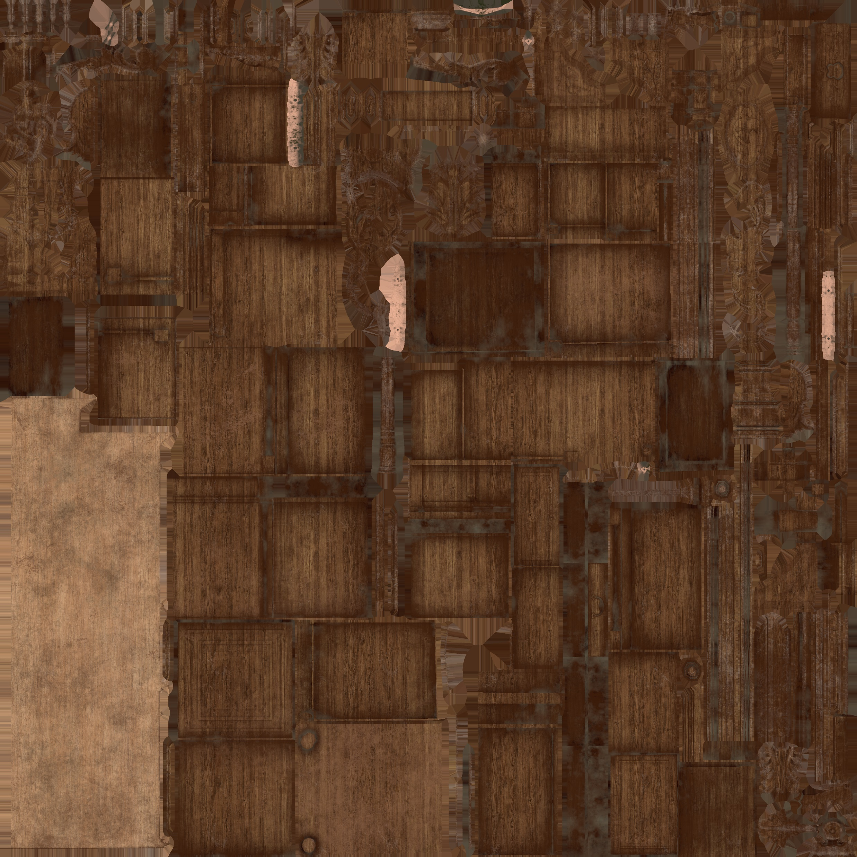
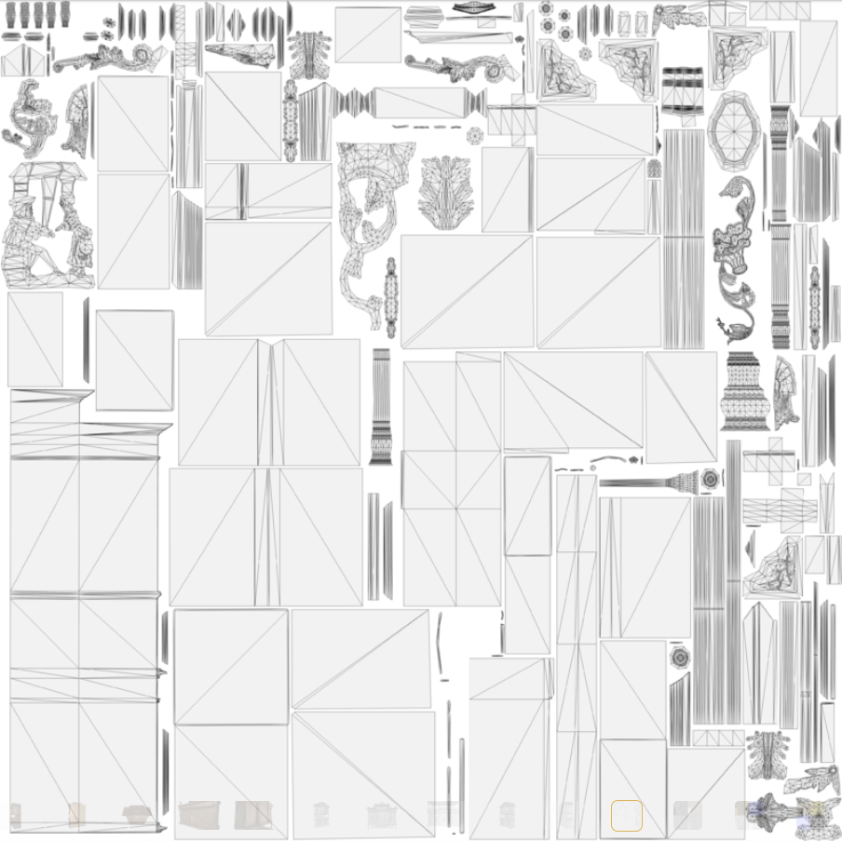
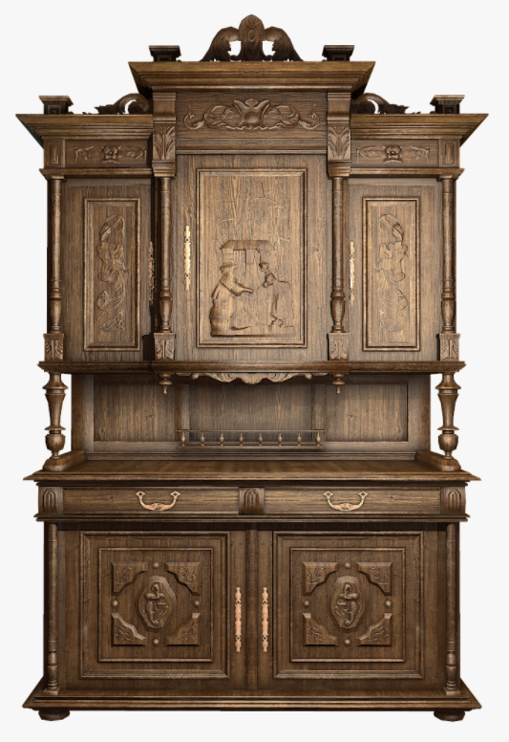
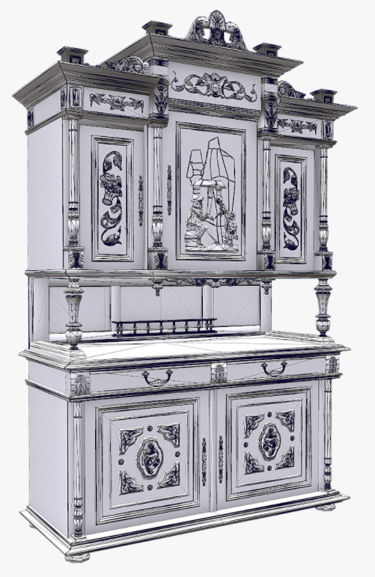

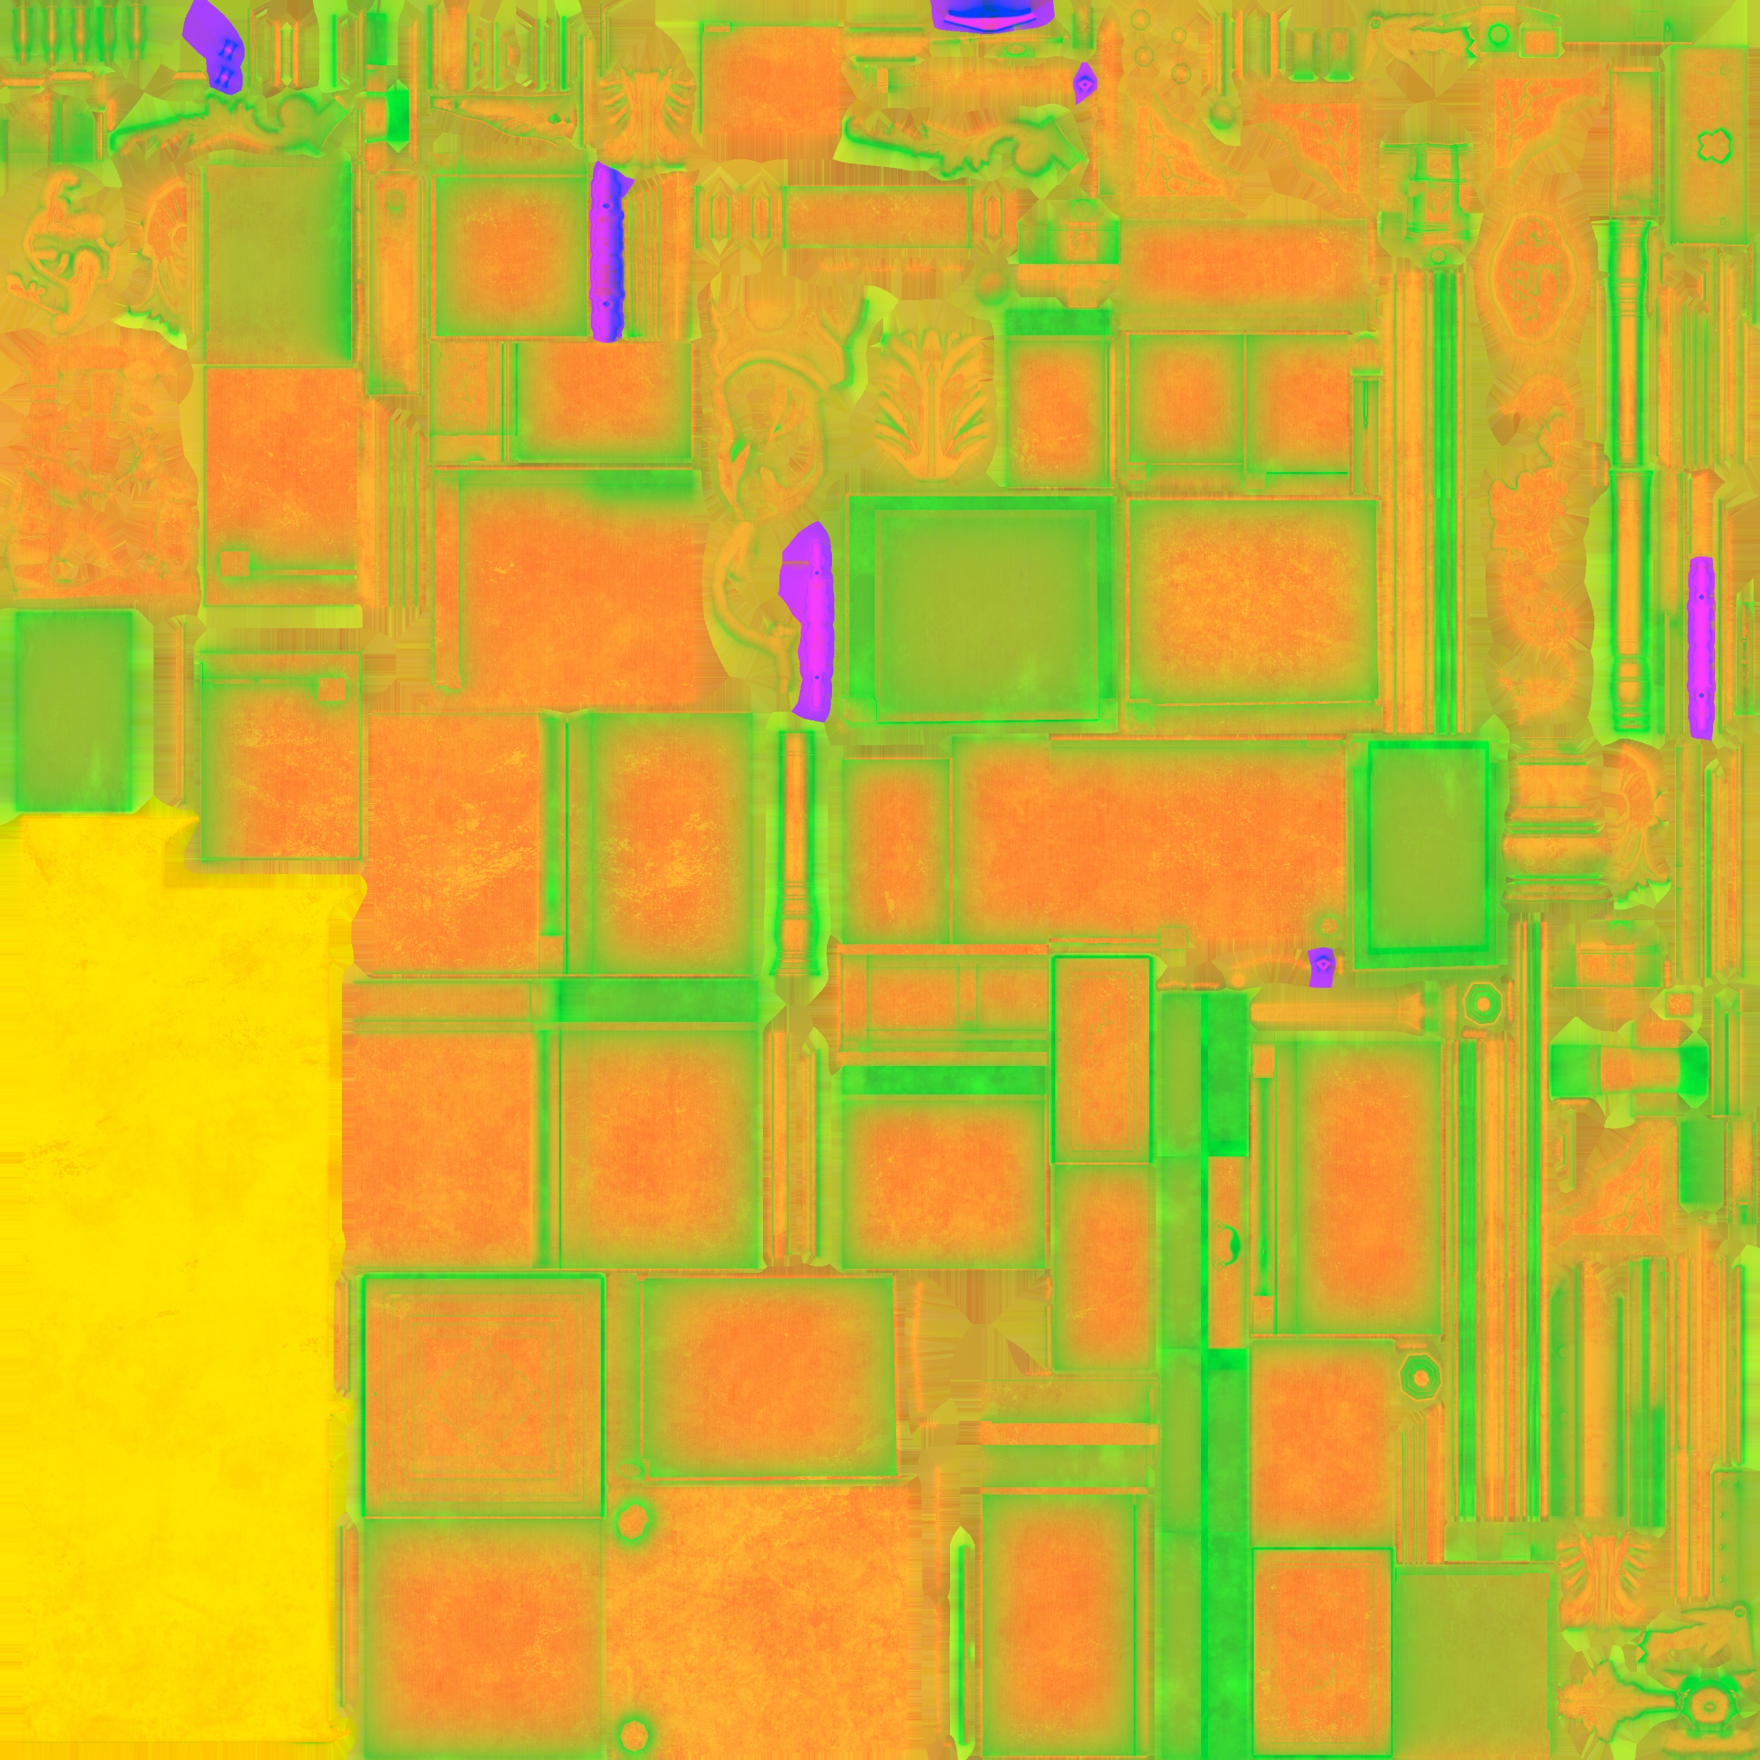

3D Model formats
UV UNWRAP
ALBEDO MAP
NORMAL MAP
ENGINE SPECIFIC MAP

Slide 3
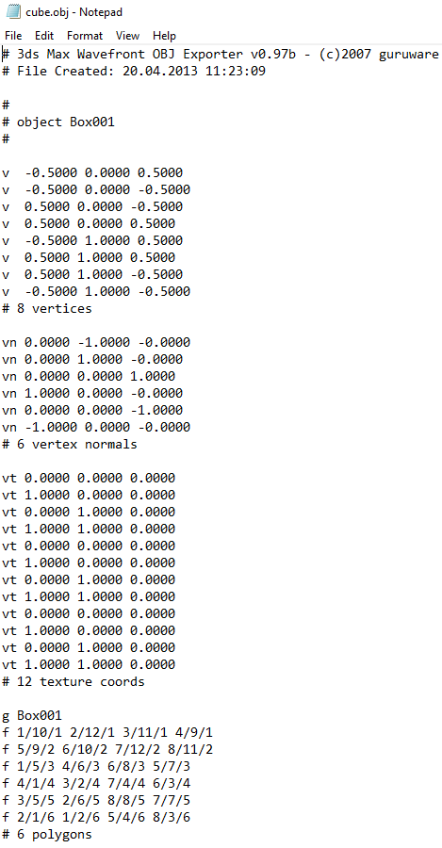
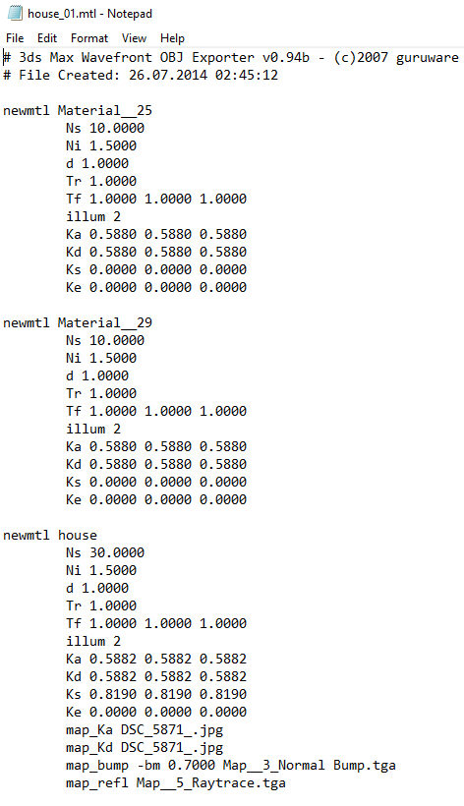
WAVEFRONT OBJECT (*.obj)
PROS:
Ubiquitous, Simple text-based format.
Uncomplicated flattened mesh hierarchy.
Great for learning, supports materials.
CONS:
Ancient format, missing lots of features.
No matrix data, No animation data.
You must Triangulate N-Sided polygons. ☹
Only supports classic materials not modern PBR style materials.

Slide 4
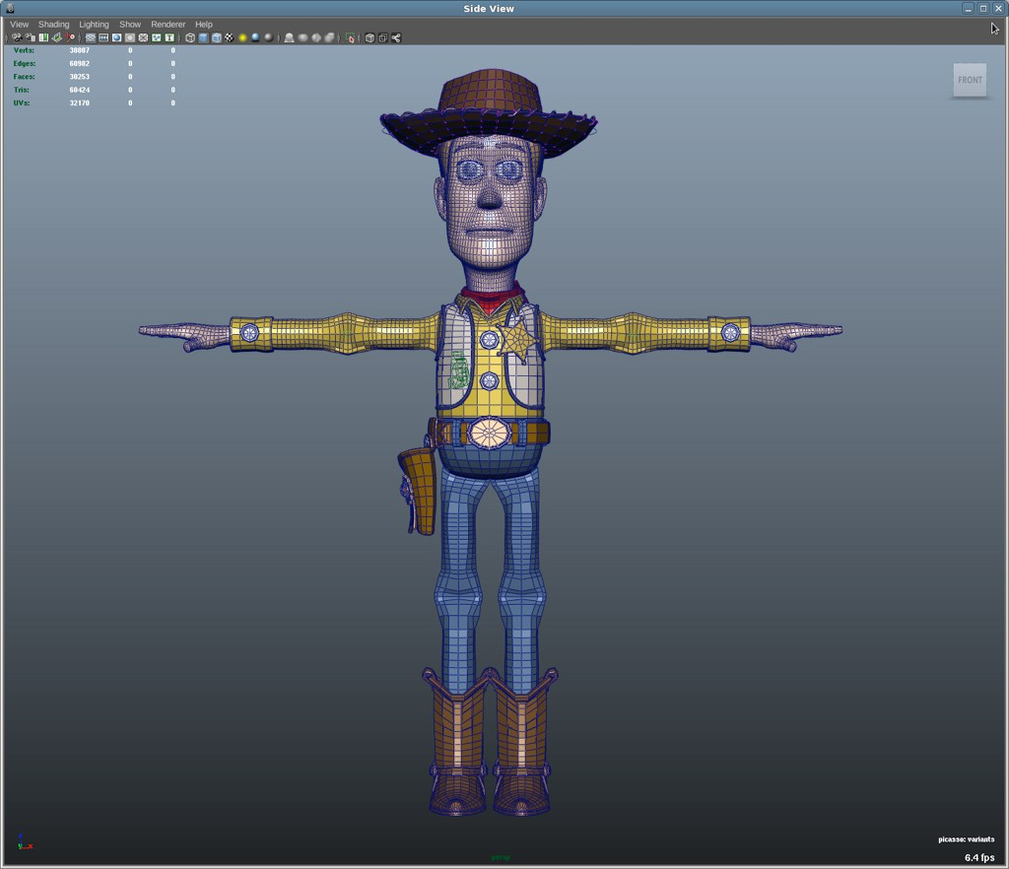
Filmbox (*.fbx)
PROS:
A 3D modeling standard, designed by Autodesk for all their various software.
Comes with its own loading SDK.
Has most everything you could want: Hierarchies, Animations, even Lights & Cameras.
CONS:
Excessively verbose and complex for direct use in real-time rendering.
Not simple, even with an SDK expect a steep learning curve.

Slide 5
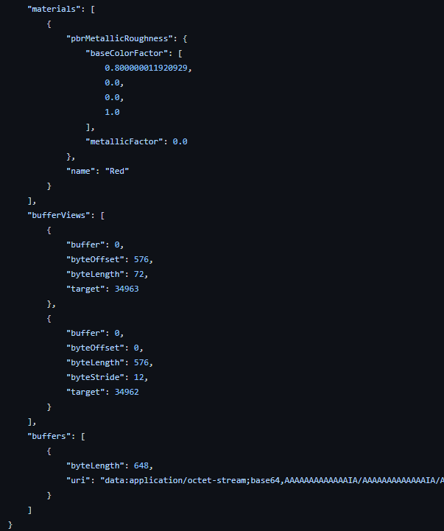
Graphics Language Transmission Format (*.gltf)
PROS:
Ultra modern format. (v2.0 in 2017)
Optimized for real-time rendering.
Supports modern PBR materials.
Supports transforms and animations.
Has a binary variant for faster loading.
CONS:
Not quite as widely supported as older formats. (growing quickly though)
Arguably more complex than an OBJ file.

Slide 6
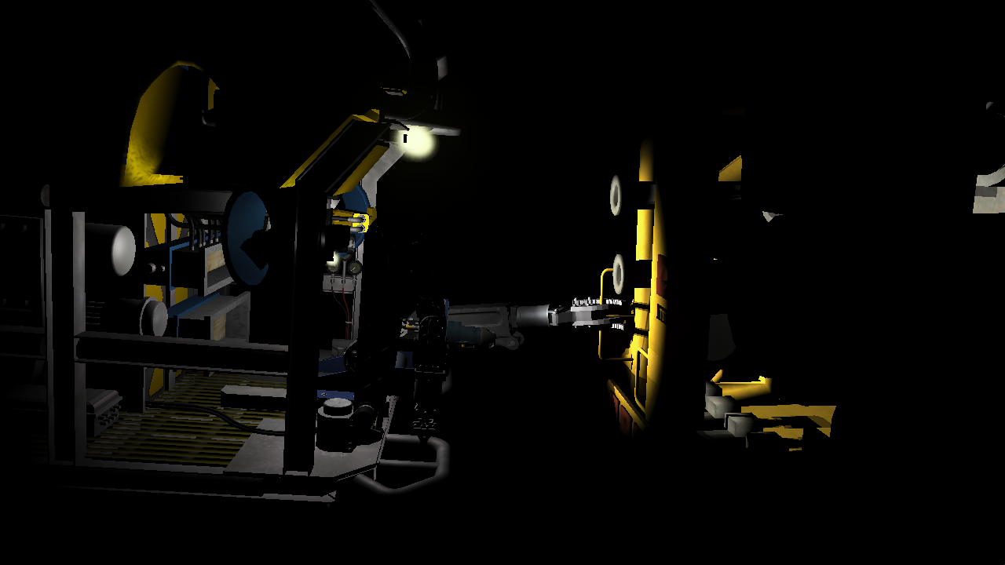
Lighting review

Slide 7
LIGHTING: REQUIRMENTS
Number of Lights?
Looping over multiple lights per-pixel can become very expensive. (suggest 8-16)
Cap the maximum active lights in the shader and/or apply the most relevant lights only.
Types of Lights?
POINT, SPOT, DIRECTIONAL
Light Attributes?
COLOR/BRIGHTNESS, DIRECTION, POSITION, AMBIENCE, CONE DIRECTION, CONE ANGLES, RADIUS
Vertex Normals (from model or procedurally generated)
Optional(but recommended) Items:
Vertex Tangents, Normal Map, Specular/Roughness Map, Metal Map, Environment Map

Slide 8
LIGHTING: EXECUTION
Adjust your vertex format to support normal vectors and (optional) tangents.
Transform these vectors from local to world space before sending to the pixel shader.
Load the relevant lighting attribute data onto the card as Uniform data.
Your pixel shader should have direct access to read this data.
Create a pixel shader that does the following for each light:
Compute direct light energy based on light type and surface normal/position
Compute indirect light from ambient light attribute (attenuated if point/spot)
Compute reflected light using eye-to-surface incidence vector (HLSL: reflect)
Use the current Mesh’s material attributes to adjust the formula below:
return saturate(totalDirect + totalIndirect) * diffuse + totalReflected + emissive

Slide 9
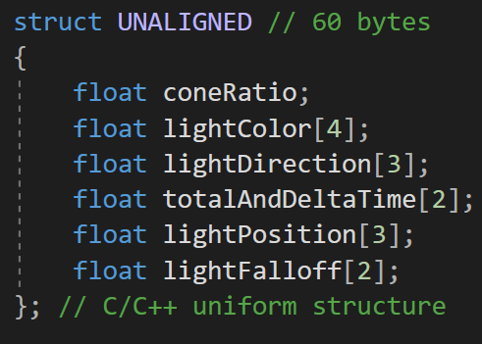
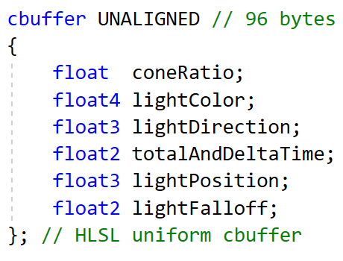
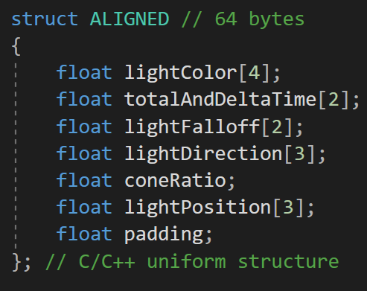
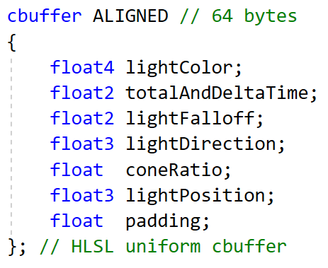
CPU to GPU UNIFORM byte ALIGNMENT ISSUES
Structures created in C/C++ typically have a 4- or 8-byte variable alignment unless otherwise specified. (32bit or 64bit)
When recreating these structures in GPU languages like HLSL/GLSL this can be a problem since the standard byte alignment is based on 16-byte registers. (128bit SIMD)
If you don’t take this into account, it can quickly result in byte differences between the two structures due to hidden padding.
This primarily impacts structs used for uniform data not Vertex data as that is designed to be tightly compacted.

Slide 10
Programming presentation
Loading and Drawing STONEHENGE

Slide 11
Q

